Slide 1
The sheltering effect of different commuting modes on PM_{2.5} exposure in Asian areas
Ming-Chien Mark Tsou, Shih-Chun Candice Lung (Taiwan), Kraichat Tantrakarnapa (Thailand), Thi Hien To (Vietnam), and others…

Slide 2
Background
Traffic-related exposure to PM_{2.5} is an issue of public concern.
Most studies monitored the personal or in-vehicle PM_{2.5} levels.
However, few studies calculated the ratio of in-vehicle to outdoor (ambient) concentrations.
A study in Hong Kong measured ambient and in-vehicle concentrations in public transport microenvironments (Che et al., 2016)

Slide 3
Scientific Questions
Do different types of commuting modes affect the PM_{2.5} infiltration rate?
Enclosed environments (cars/bus)
Modes which direct exposure to outdoor air (scooters/bicycles/walking)
Do different types of vehicles affect the PM_{2.5} infiltration rate?
Different design of car body under the same scenario
ex. private car and bus with the windows open
Are the PM_{2.5} infiltration rates different between areas under the same scenario?
ex. private car with the windows open in different cities

Slide 4
Objectives
To compare the ratio of commuting (in-vehicle/personal) to outdoor PM_{2.5} levels (C/O ratio)
Between indoor and outdoor commuting modes
Between different vehicle types (private car vs bus…)
Between different areas

Slide 5
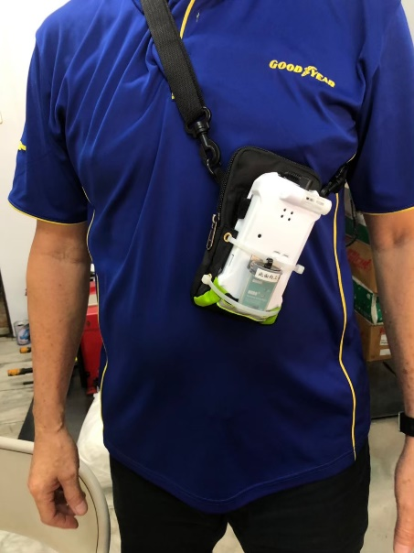
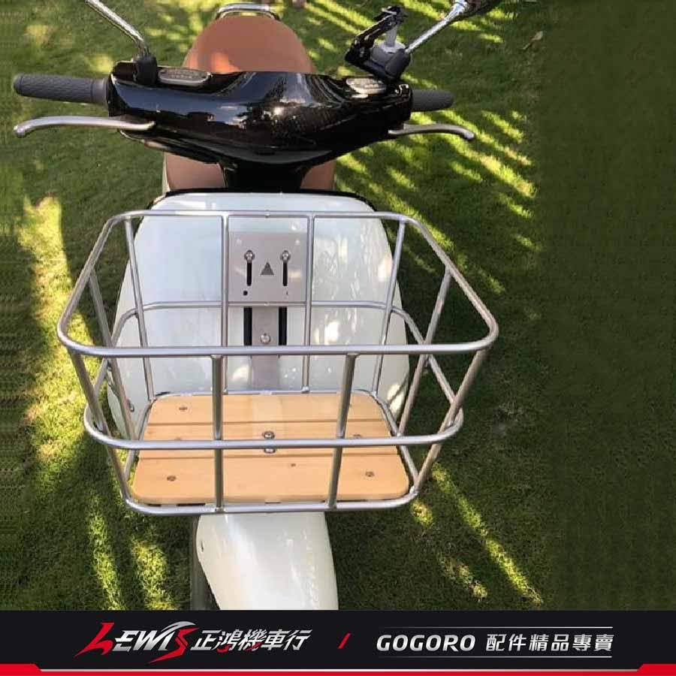
Study design
Resolution: 5 minutes
In-vehicle/personal PM_{2.5} monitoring
AS-LUNG or other instruments can be carried by passengers or can be set up in the vehicles or near the handler (scooter or bicycle)
Please record the exposure sources other than traffic if you had exposed to other obvious sources such as environmental tobacco smoke
Outdoor (ambient) PM_{2.5} monitoring
The nearby air quality monitoring stations (at the high-level site (about 10 m above ground)) or the stations for the city
The background station near the monitoring area (within about 10 km)
University, park, and so on…

Slide 6

Data availability
 | C/I ratio >= 1 | C/I ratio < 1
Mean outdoor PM_{2.5} levels (μg/m³) | 16.1 ± 7.8 | 25.0 ± 9.1
Taiwan
Preliminary result
Total of 4391 5-min means of PM_{2.5} data
Mean ambient PM2.5 levels: 24.8 ± 12.8 μg/m³
$$\frac{\text{Commuting} \text{PM}\text{2.5} \text{levels} }{\text{Outdoor} \text{PM}\text{2.5} \text{levels}}$$
 |  | C/I ratio
Modes | n | Mean ± SD | Min | Max | C/I ratio >= 1
Walking | 558 | 0.71 ± 0.47 | 0.06 | 6.09 | 8.78%
Bicycle | 309 | 0.75 ± 0.52 | 0.04 | 5.47 | 11.0%
Scooter | 1339 | 0.83 ± 0.47 | 0.08 | 3.74 | 19.4%
Car | 867 | 0.52 ± 0.39 | 0.05 | 4.03 | 7.8%
Bus | 385 | 0.78 ± 0.65 | 0.18 | 5.49 | 15.1%
MRT | 495 | 0.69 ± 0.32 | 0.05 | 2.65 | 12.5%
Train | 35 | 0.56 ± 0.15 | 0.32 | 0.86 | 0%
higher

Slide 7
Data availability
Thailand
Vietnam

Slide 8
Thank you for your attention

Slide 9
Notice
Please provide the picture of vehicles to help to identify the type of commuting modes.
Please exclude the data during the raining hours.
Please record the exposure sources other than traffic if you had exposed to other obvious sources in the 5-min segments.
If you do not use AS-LUNG to monitor the PM levels, please provide the information of the instruments (including the name and its manufacturer, city and country).
Duration for data collection: 2 months (to the end of September 2021)

Slide 10
Modes | n | Mean ± SD | Min | Max | C/I ratio >= 1
Car
Window closed, AC-off | 26 | 0.90 ± 0.23 | 0.42 | 1.38
Window open, AC-off | 63 | 0.53 ± 0.29 | 0.24 | 1.70
AC-on | 736 | 0.50 ± 0.40 | 0.05 | 4.03
Bus
Window closed, AC-off | 28 | 0.99 ± 0.45 | 0.24 | 1.71
Window open, AC-off | 6 | 1.43 ± 1.29 | 0.63 | 3.92
AC-on | 339 | 0.76 ± 0.65 | 0.18 | 5.49
MRT
Window closed, AC-off | 6 | 0.62 ± 0.13 | 0.44 | 0.83
Window open, AC-off | 0 | - | - | -
AC-on | 465 | 0.67 ± 0.30 | 0.05 | 2.65
Train
AC-on | 35 | 0.56 ± 0.15 | 0.32 | 0.86 | 0

